Slide 1

The Why and How of Reproducible Research
WQD7001

Slide 2
Have you ever tried to reproduce the results presented in a research paper?

Slide 3
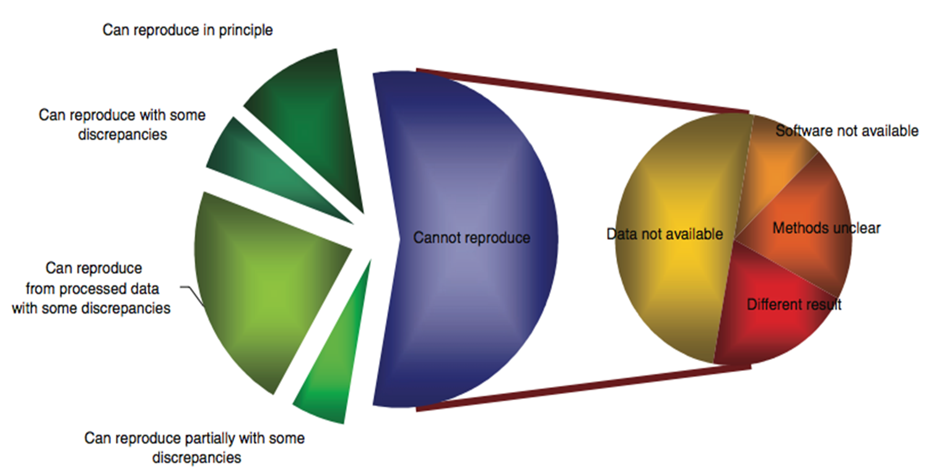
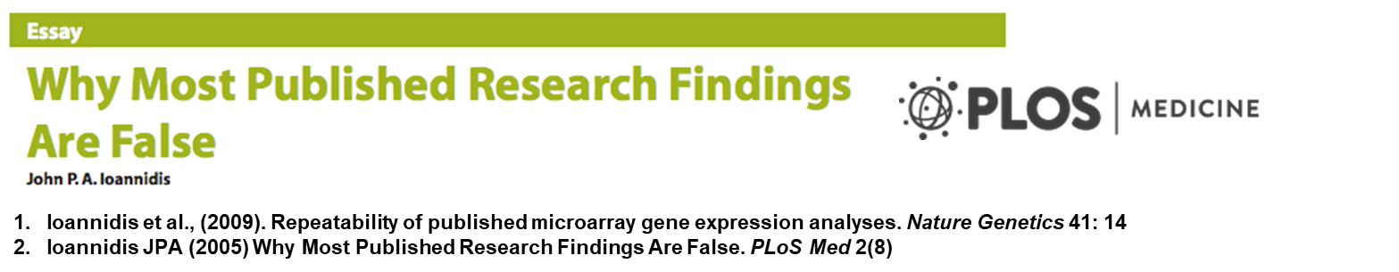
Out of 18 microarray papers, results
from 10 could not be reproduced

Slide 4
Presentation Outline
The Why
Reproducibility Crisis
Causes of Non-Reproducibility in Scientific Literature
Consequences
Science
What is Reproducible Research?
Replication vs. Reproducibility
Degrees of Reproducibility
Terminology
Tracing Origin of Reproducible Research
Why do Reproducible Research?
Advantages of Reproducible Research
Challenges to Reproducible Research
The How
How to Implement Reproducible Research?
Reproducible Research 101
Tools to Aid in Reproducible Research
Reproducibility Skills
Copyright and Licensing
Rights for Data
A Hierarchy of Reproducibility
Models for Reproducibility
References
Conclusion

Slide 5
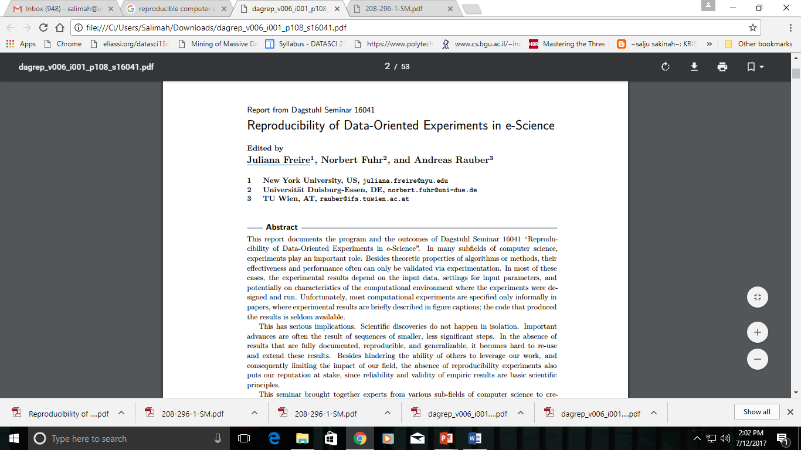
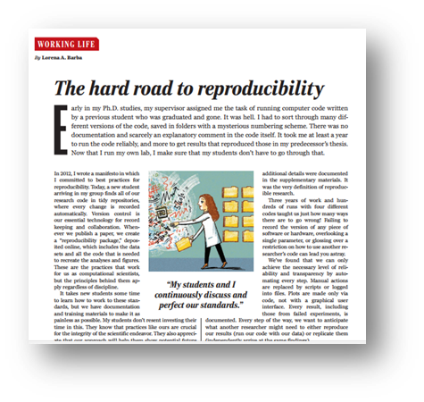
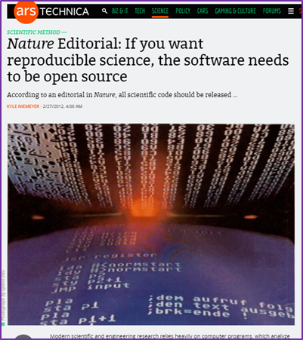
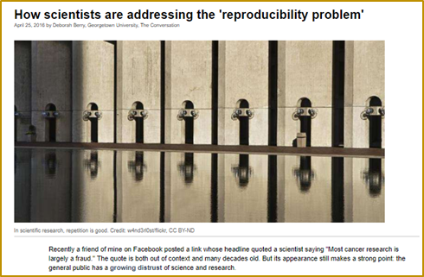
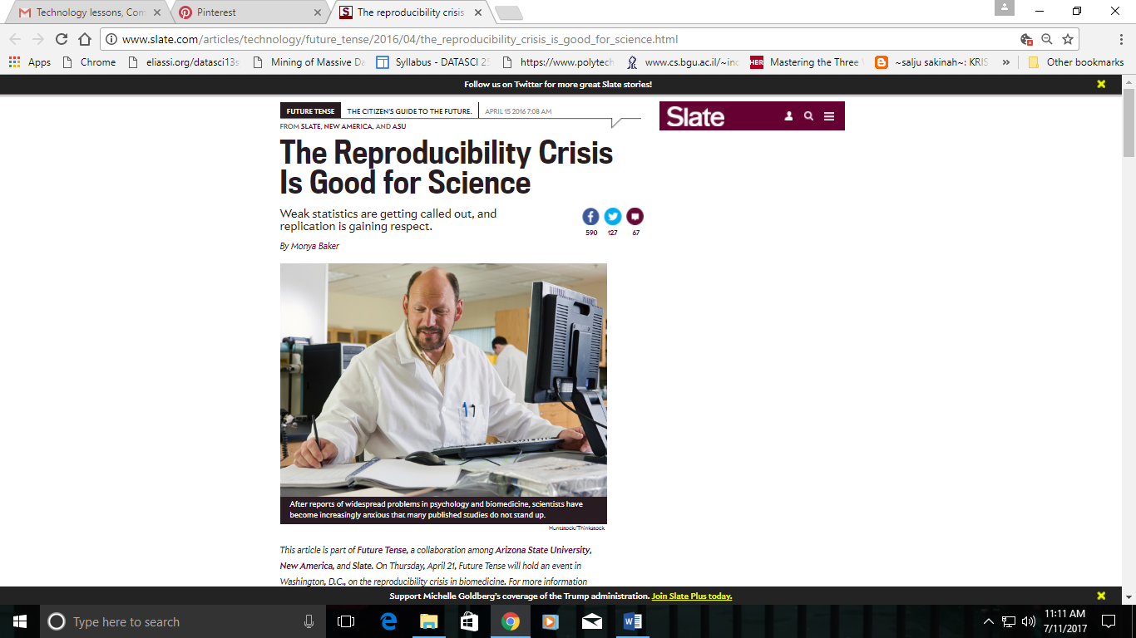
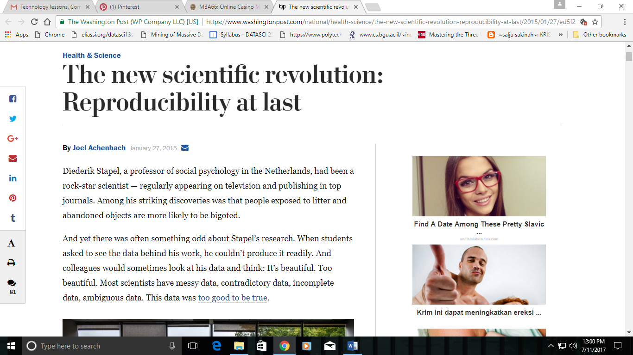
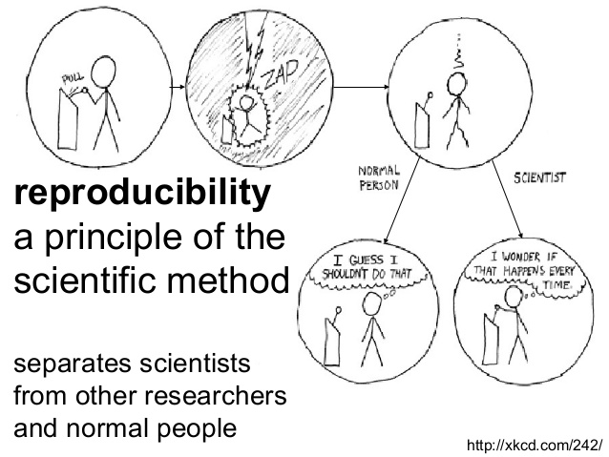

Slide 6
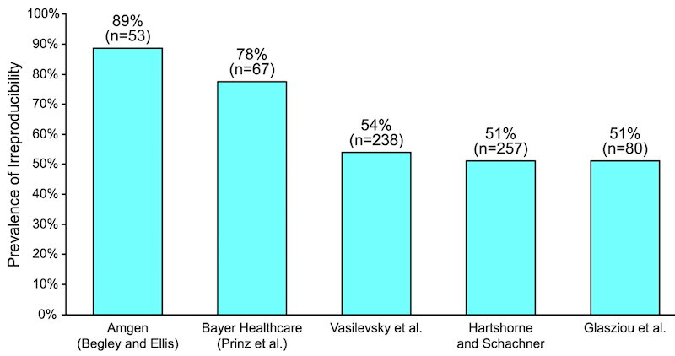
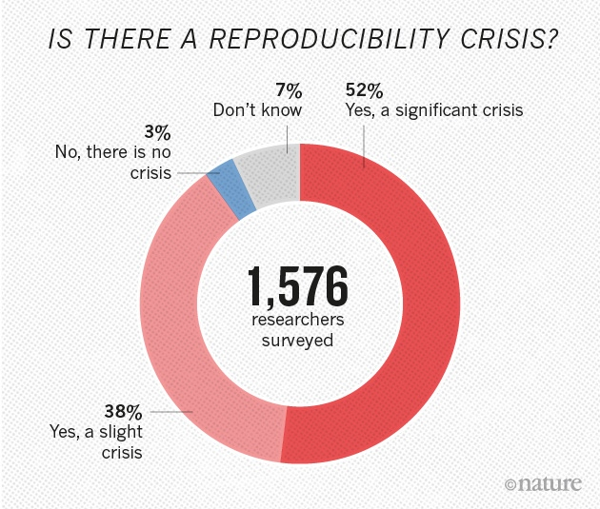
Scientific Reproducibility Crisis
Reproducibility crisis - the situation that a large percentage (between 51% and 89%) of the academic literature is not reproducible.
History of the reproducibility crisis
Reproducibility has also recently been found to be an issue in psychology and computer science.
Work highlighting the scale of the reproducibility crisis
A project called “The Reproducibility Initiative” - focused on examining reproducibility levels in multiple scientific fields
http://validation.scienceexchange.com/#/reproducibility-initiative
Reference: Leonard Freedman, Iain Cockburn, and Timothy Simcoe, “The Economics of Reproducibility in Preclinical Research.” PLOS Biol 2015
http://journals.plos.org/plosbiology/article?id=10.1371/journal.pbio.1002165

Slide 7
Solution to Reproducibility Crisis
Open Research – scientific knowledge of all kinds should be openly shared as early as it is practical in the discovery process.
Therefore, need to reward the publication of research outputs along the entire process, NOT just each journal article as it is published.
Open Science
Transparency
Truth

Slide 8
Causes of Non-Reproducibility in Scientific Literature
Scholarly articles are merely advertisement of scholarship . The actual scholarly artefacts, i.e. the data and computational methods, which support the scholarship, remain largely inaccessible.
--- Jon B. Buckheit and David L. Donoho, WaveLab and reproducible research, 1995
Traditional publishing policies and practices a hindrance (licensing & access, embargoes, Ingelfinger, closed doors, anti-granularity & forking).
Lack of transparency, lack of credit for anything other than 350-year old style “dead tree” publication.
Scientists writing papers do not have a strong enough incentive to ensure that their paper will be reproducible.
A result might be a fluke, and there is not sufficient incentive, other than one's integrity, to check whether it is a fluke.
The incentive structures in universities and the attitude that you “publish or perish” means that researchers prioritize “getting it published” over “getting it right”.
When determining how good an article is, current peer-review system is limited to asking two people for their opinions. Two people is not enough!
Source: What is the reproducibility crisis, and what can the academic community to do solve it? Richard Price, Founder of Academia.edu, on Quora
https://www.forbes.com/sites/quora/2017/02/09/how-the-reproducibility-crisis-in-academia-is-affecting-scientific-research/#319fece13dad

Slide 9
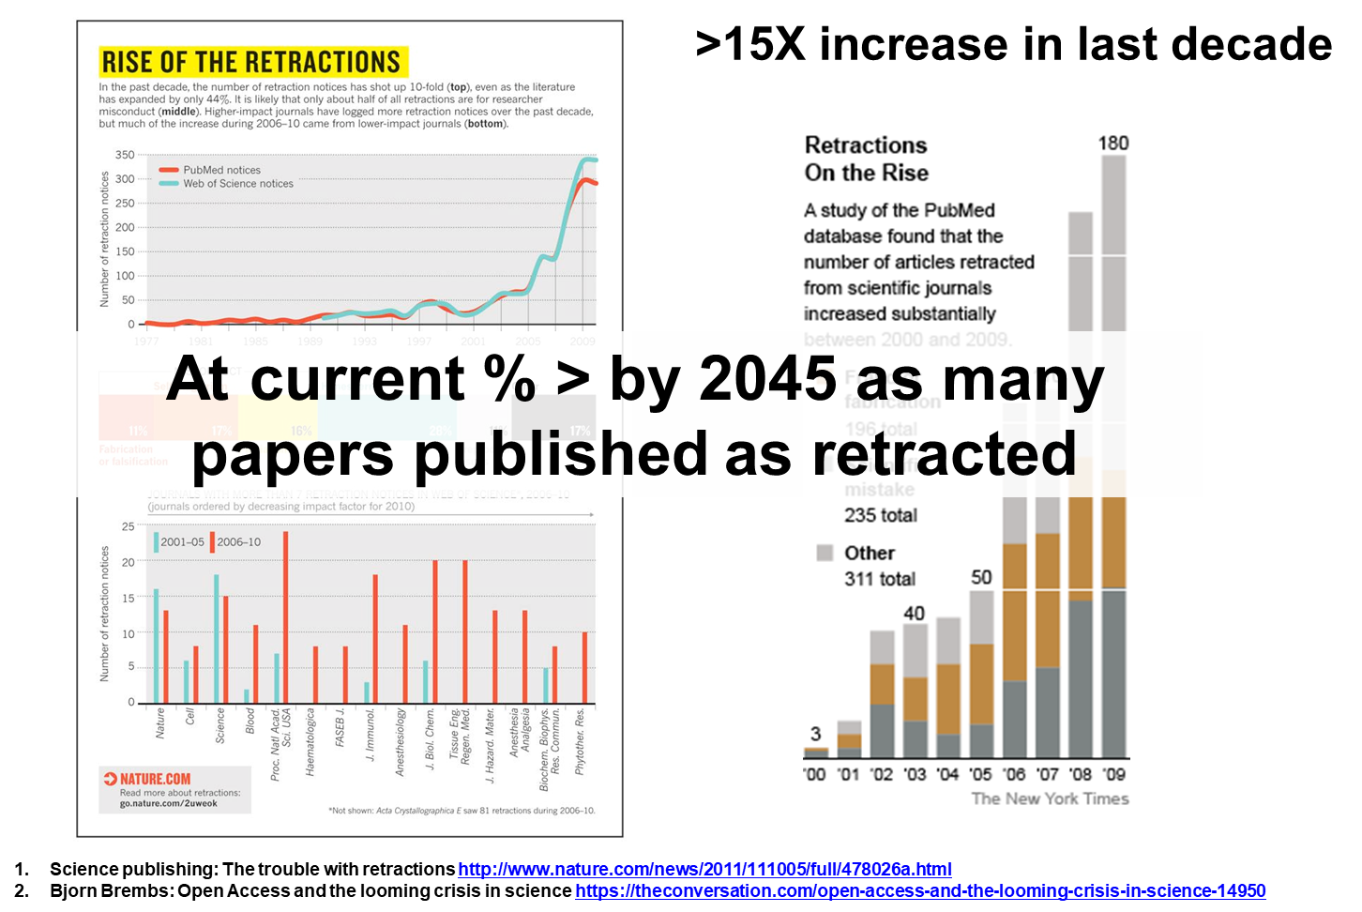
Consequences
Growing replication gap (refer to slide 3)
Increasing number of retractions

Slide 10
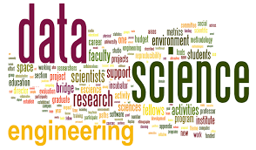
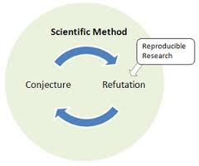

Science
Science is the systematic enterprise of gathering knowledge about the universe and organizing and condensing that knowledge into testable laws and theories.
The success and credibility of science are anchored in the willingness of scientists to independent testing and replication by other scientists.
Scientific evidence is strengthened when important findings are replicated by independent investigators, data, methods, laboratories, instruments, etc.
This requires the complete and open exchange of data, procedures and materials.
Scientific publications have at least two goals:
to announce a result.
to convince readers that the result is correct.
Therefore
papers in experimental [and computational science] should describe the results and provide a clear enough protocol [or algorithm] to allow successful repetition and extension.
Jill Mesirov
Accessible Reproducible Research
Science 22 January 2010:
Vol. 327 no. 5964 pp. 415-416
DOI: 10.1126/science.1179653
Is there a reproducibility crisis in science? - Matt Anticole
https://ed.ted.com/lessons/is-there-a-reproducibility-crisis-in-science-matt-anticole

Slide 11
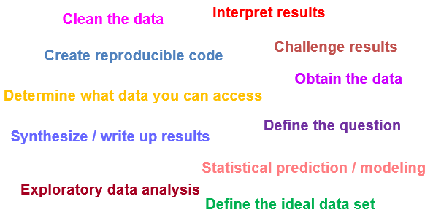
Steps in a Data Analysis

Slide 12
Structure of Data Analysis
A suggested structure for data analysis has the following components:
A good question (needs narrowing down, so that data that is required is not huge)
What is the ideal dataset?
Solving a descriptive problem – use a sample of the entire population.
Inference –use smaller dataset to make a conclusion on a larger population.
Prediction – use a test and training set.
Casual analysis – use experimental data.
The real dataset
Keep a reference to where it is sourced from.
Cleaning the data
Understand how data was acquired, record down all cleaning steps.

Slide 13
Structure of Data Analysis (continue)
Exploratory data analysis
Use the head function to display the first few lines of your data, pairwise correlations, hierarchical cluster analysis
Statistical modelling and prediction
Fit data to a generalized statistical model
Interpreting the results
Use appropriate language, key words include : correlation, association, prediction
Challenge the findings
Be self-analytical or critical of the work done
Synthesize the results
Telling a good story, steps need not be hierarchical
Reproducible results
Preserve code and documentation using knitr

Slide 14
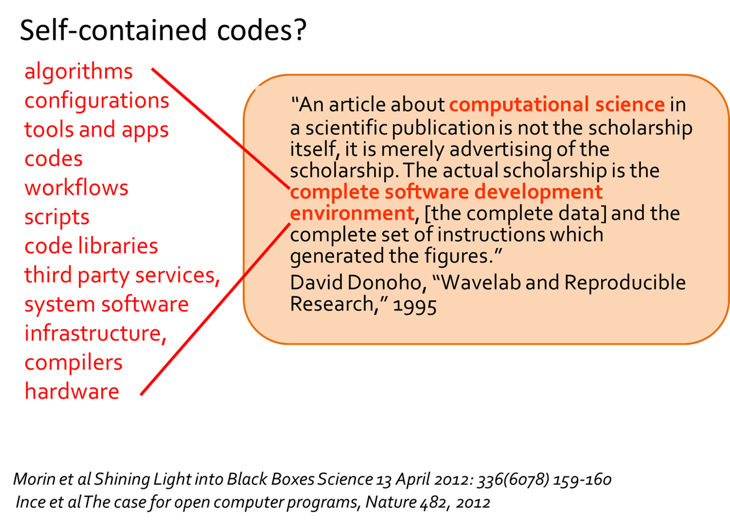
What is Reproducible Research (RR)?
A study is said to be reproducible [Roger Peng], if
the analytic data are made available;
the statistical methods are fully described and computer code is made available;
documentation for both data and methods made available; and
standard methods of distribution are employed.
RR is about communicating what you have exactly to others.
Reproducibility is critical for studies where the likelihood for full replication within a relevant time window is very low.
Computational reproducibility - all details of computation (code and data) are made routinely available to others.

Slide 15
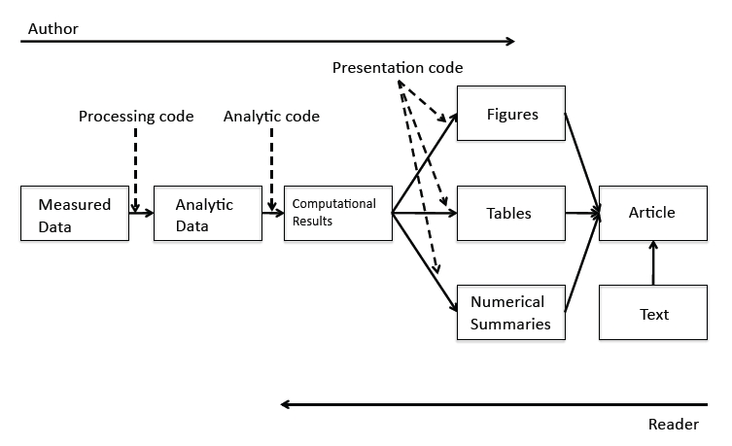
What is Reproducible Research?
Reproducible research is the ultimate standard for strengthening scientific evidence by independent:
Investigators
Data
Analytical methods
Laboratories
Instruments
Goal is to expose the reader to more of the research workflow.

Slide 16
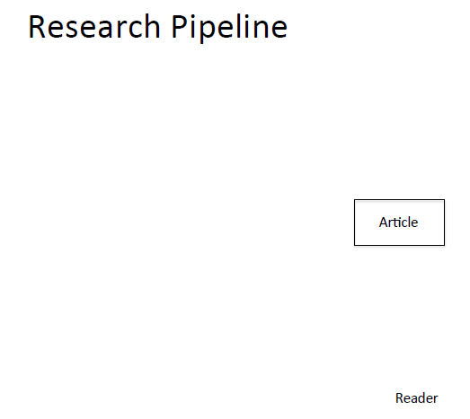
READER

Slide 17
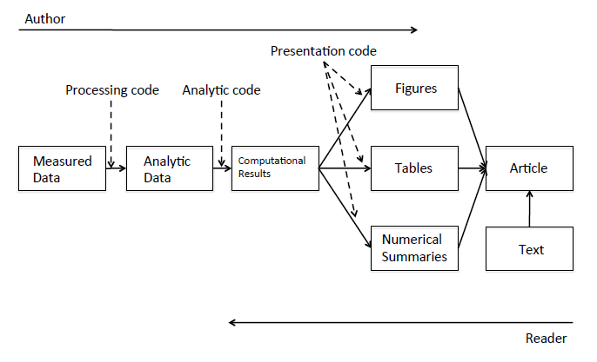
Adopting RR in your data science project

Slide 18
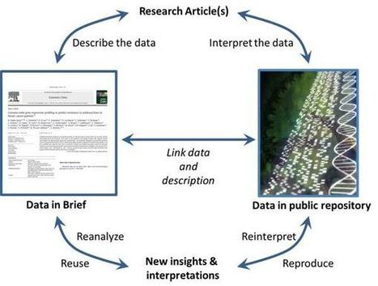

Slide 19
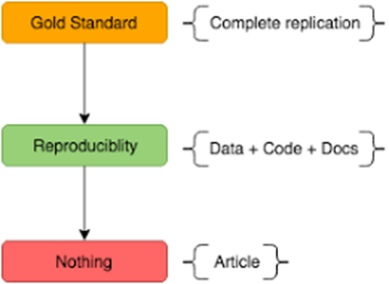
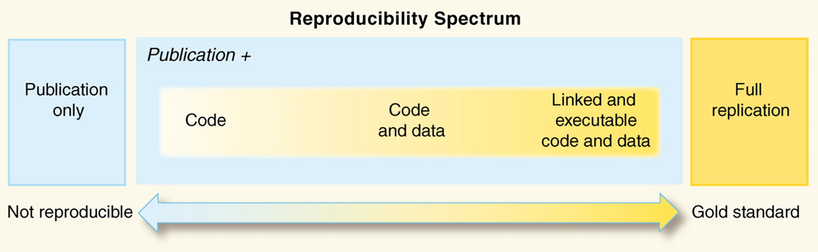
Replication vs. Reproducibility
Replication: The confirmation of results and conclusions from one study obtained independently in another is considered the scientific gold standard.
“Again, and Again, and Again …” BR Jasny et. al. Science, 2011. 334(6060) pp. 1225 DOI: 10.1126/science.334.6060.1225
Some studies can’t be replicated: too big, too costly, too time consuming, one time event, rare samples.
Reproducibility: minimum standard for assessing the value of scientific claims, particularly when full independent replication of a study is not feasible.
“Reproducible Research in Computational Science”. RD Peng Science, 2011. 334 (6060) pp. 1226-1227 DOI: 10.1126/science.1213847

Slide 20
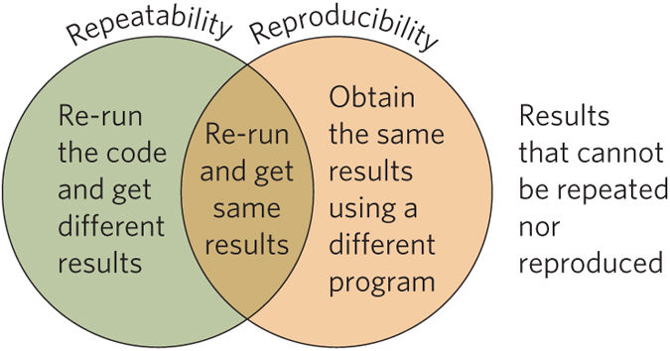
Source: https://www.nature.com/articles/ngeo2283#f1

Slide 21
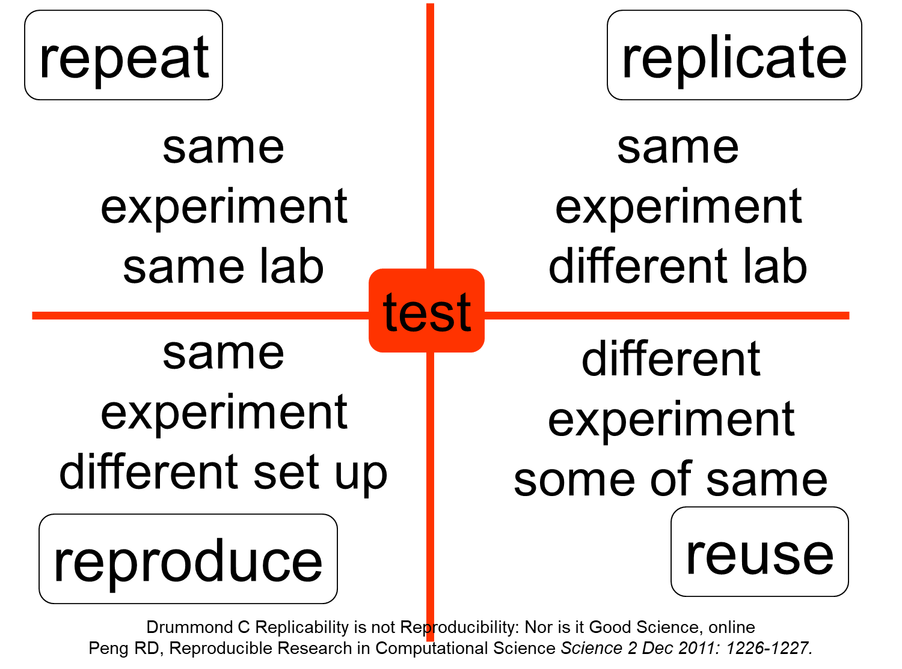
CERTIFY
DEFEND
TRANSFER
COMPARE

Slide 22
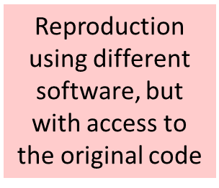
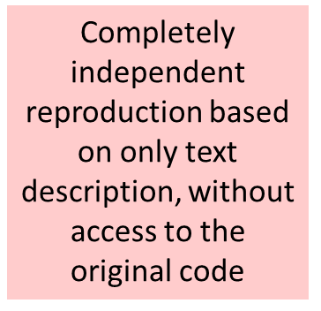
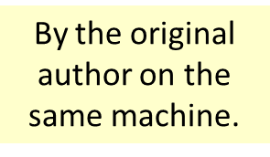
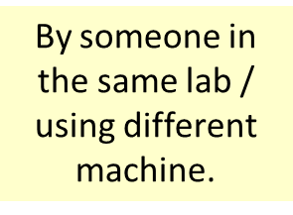
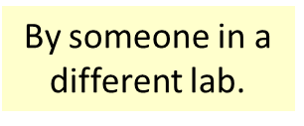
Replication vs. Reproducibility
Replicability
Reproducibility
Reproduction of the original results using the same tools.

Slide 23
Degrees of Reproducibility
0 - The results cannot be reproduced by an independent researcher.
1 - The results cannot seem to be reproduced by an independent researcher.
2 - The results could be reproduced by an independent researcher, requiring extreme effort.
3 - The results can be reproduced by an independent researcher, requiring considerable effort.
4 - The results can be easily reproduced by an independent researcher with at most 15 minutes of user effort, requiring some proprietary source packages (MATLAB, SAS, etc.)
5 - The results can be easily reproduced by an independent researcher with at most 15 min of user effort, requiring only standard, freely available tools (C compiler, R, Python, etc.)
Reference: P. Vandewalle, J. Kovacevic and M. Vetterli, "Reproducible Research in Signal Processing - What, Why, and How," IEEE Signal Processing Magazine, 2009
https://infoscience.epfl.ch/record/136640/files/VandewalleKV09.pdf

Slide 24
Terminology
Reviewable Research - The descriptions of the research methods can be independently assessed and the results judged credible. (This includes both traditional peer review and community review, and does not necessarily imply reproducibility.)
Replicable Research - Tools are made available that would allow one to duplicate the results of the research, for example by running the authors’ code to produce the plots shown in the publication. (Here tools might be limited in scope, e.g., only essential data or executables, and might only be made available to referees or only upon request.)
Confirmable Research - The main conclusions of the research can be attained independently without the use of software provided by the author. (But using the complete description of algorithms and methodology provided in the publication and any supplementary materials.)
Auditable Research - Sufficient records (including data and software) have been archived so that the research can be defended later if necessary or differences between independent confirmations resolved. The archive might be private, as with traditional laboratory notebooks.
Open or Reproducible Research - Auditable research made openly available. This comprised well-documented and fully open code and data that are publicly available that would allow one to (a) fully audit the computational procedure, (b) replicate and also independently reproduce the results of the research, and (c) extend the results or apply the method to new problems.
Source: https://icerm.brown.edu/tw12-5-rcem/icerm_report.pdf

Slide 25
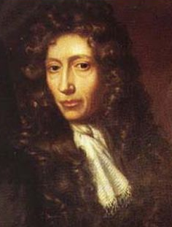

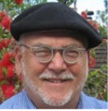
Tracing Origin of Reproducible Research
Robert Boyle (1660) – a discovery should be reproducible before being accepted as scientific knowledge.
Donald Knuth (1984) – Literate programming.
Jon Claerbout (1990) – Coined the term RR
Introduced these practices in his Stanford Exploration Project (SEP) lab working on geophysics research.
Buckheit and Donoho (1995) at Stanford
Applied RR to wavelet research using MATLAB.
Developed the WaveLab toolbox to reproduce the results from a set of their publications.
“Instead of imagining that our main
task is to instruct a computer what to do, let us concentrate rather on explaining to human beings what we want a computer
to do.”
Donald E. Knuth. Literate Programming. The Computer Journal, 27(2):97-l11, May 1984.
J. Claerbout, “Electronic documents give reproducible research a new meaning,” in Proc. 62nd Ann. Int. Meeting of the Soc. of Exploration Geophysics,1992, pp. 601–604.
J. B. Buckheit and D. L. Donoho. (1995). “WaveLab and reproducible research,” Dept. of Statistics, Stanford Univ., Tech. Rep. 474.

Slide 26
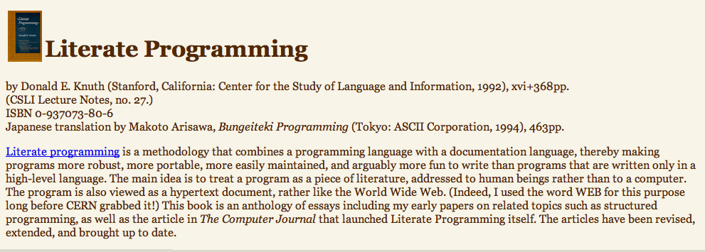
Evolution of Literate Programming
HTML - HyperText Markup Language, used to create web pages. Developed in 1993
LaTeX – a typesetting system for production of technical/scientific documentation, PDF output. Developed in 1994
Sweave – a tool that allows embedding of the R code in LaTeX documents, PDF output. Developed in 2002
reStructuredText - a markup syntax that plays well with Python and Sphinx documentation. Developed in 2002
Markdown – a lightweight markup language for plain text formatting syntax. Easily converted to HTML. Developed in 2004

Slide 27
Literate Programming
Literate programming can be a useful way to put text, code, data, output all in one document.
Original idea comes from Don Knuth.
An article is a stream of text and code.
Analysis code is divided into text and code “chunks”.
Presentation code formats results (tables, figures, etc.)
Article text explains what is going on.

Slide 28
Literate Programming
Literate programs are weaved to produce human-­‐readable documents and tangled to produce machine-­‐readable documents.
Literate programming is a general concept. We need:
A documentation language
A programming language
The original Sweave system developed by Friedrich Leisch used LaTeX and R.
Knitr supports a variety of documentation languages.

Slide 29
Literate Programming: Pros
The Pros
Text and code all in one place, logical order.
Data, results automatically updated to reflect external changes.
Code is live--‐--‐automatic “regression test” when building a document
The Cons
Text and code all in one place; can make documents difficult to read, especially if there is a lot of code.
Can substantially slow down processing of documents (although there are tools to help).

Slide 30
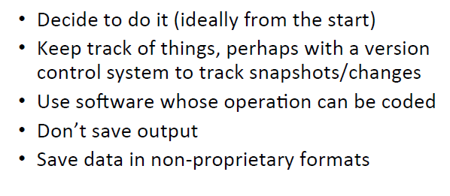
How Do I Make My Work Reproducible?

Slide 31
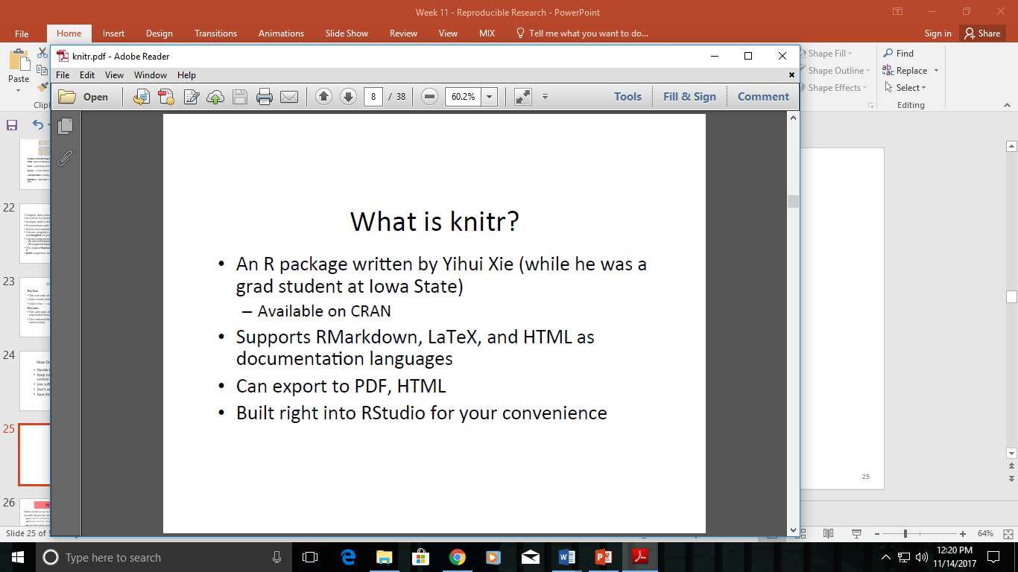
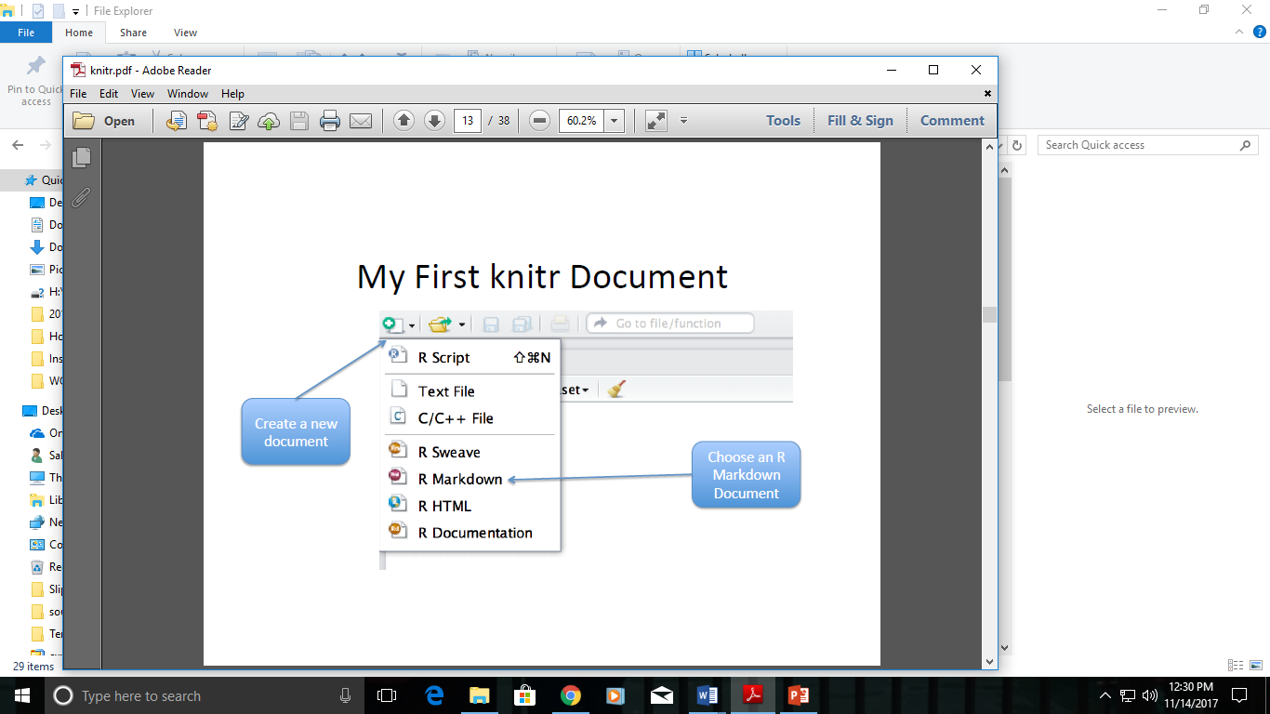
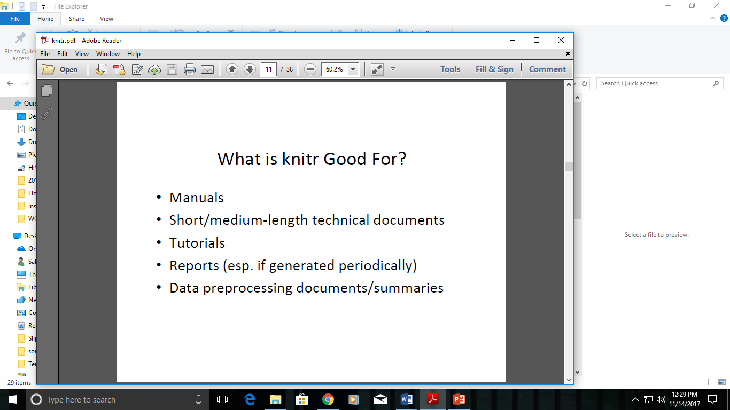
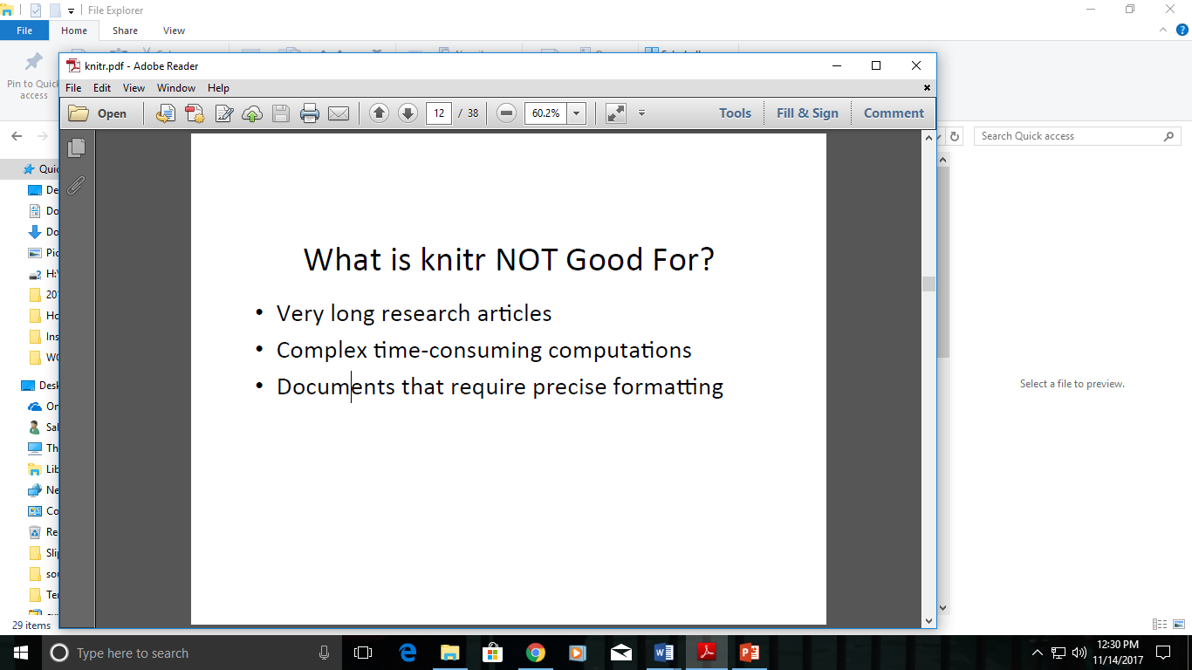

Slide 32
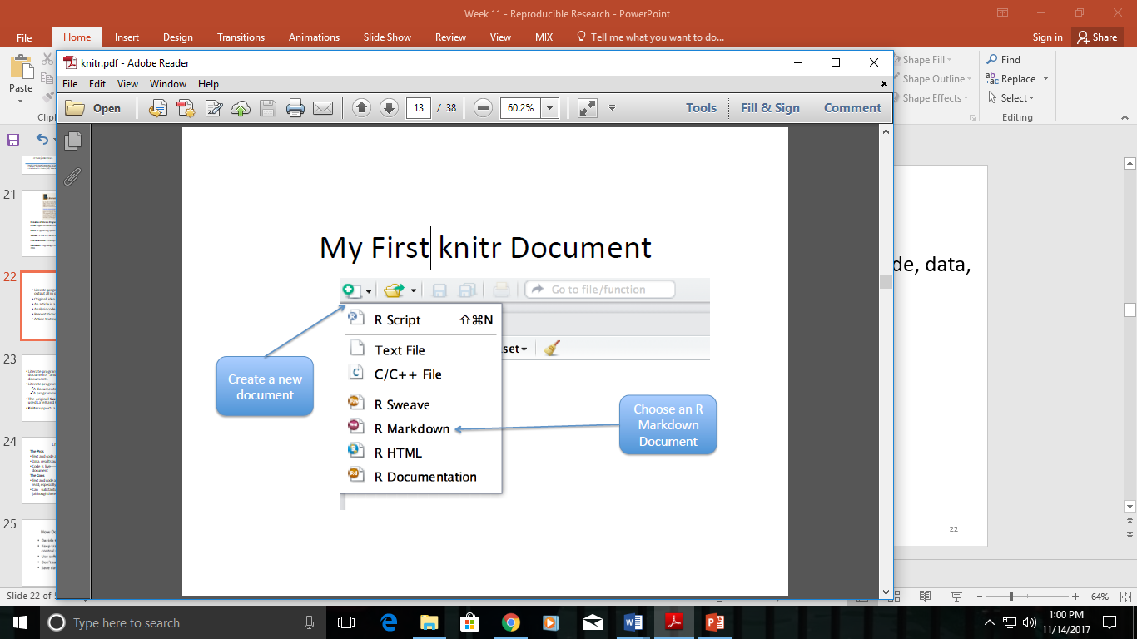
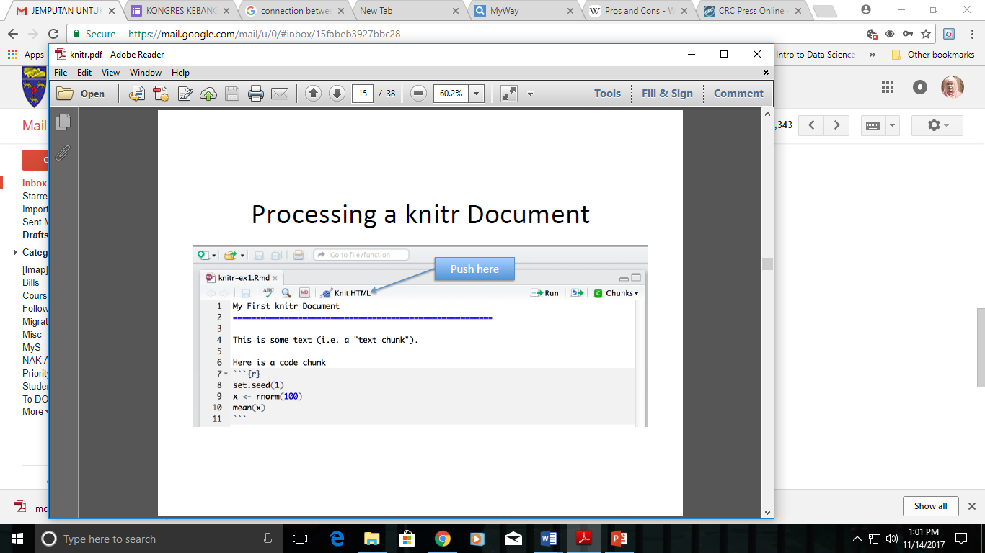
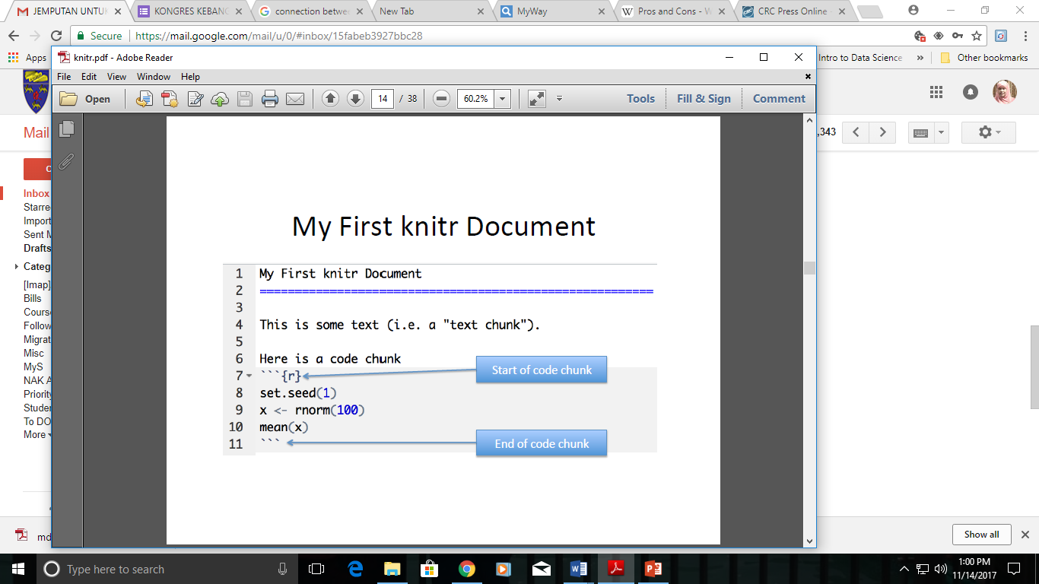
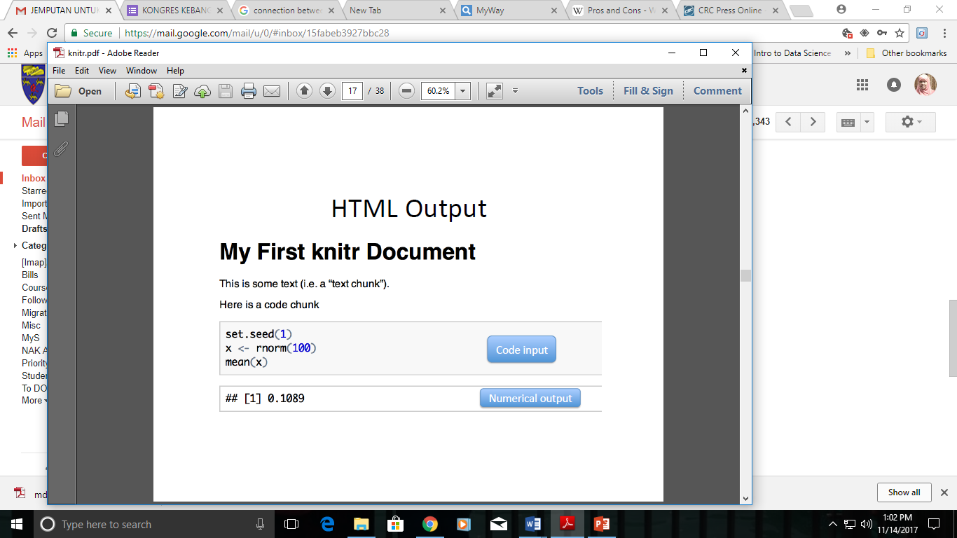

Slide 33
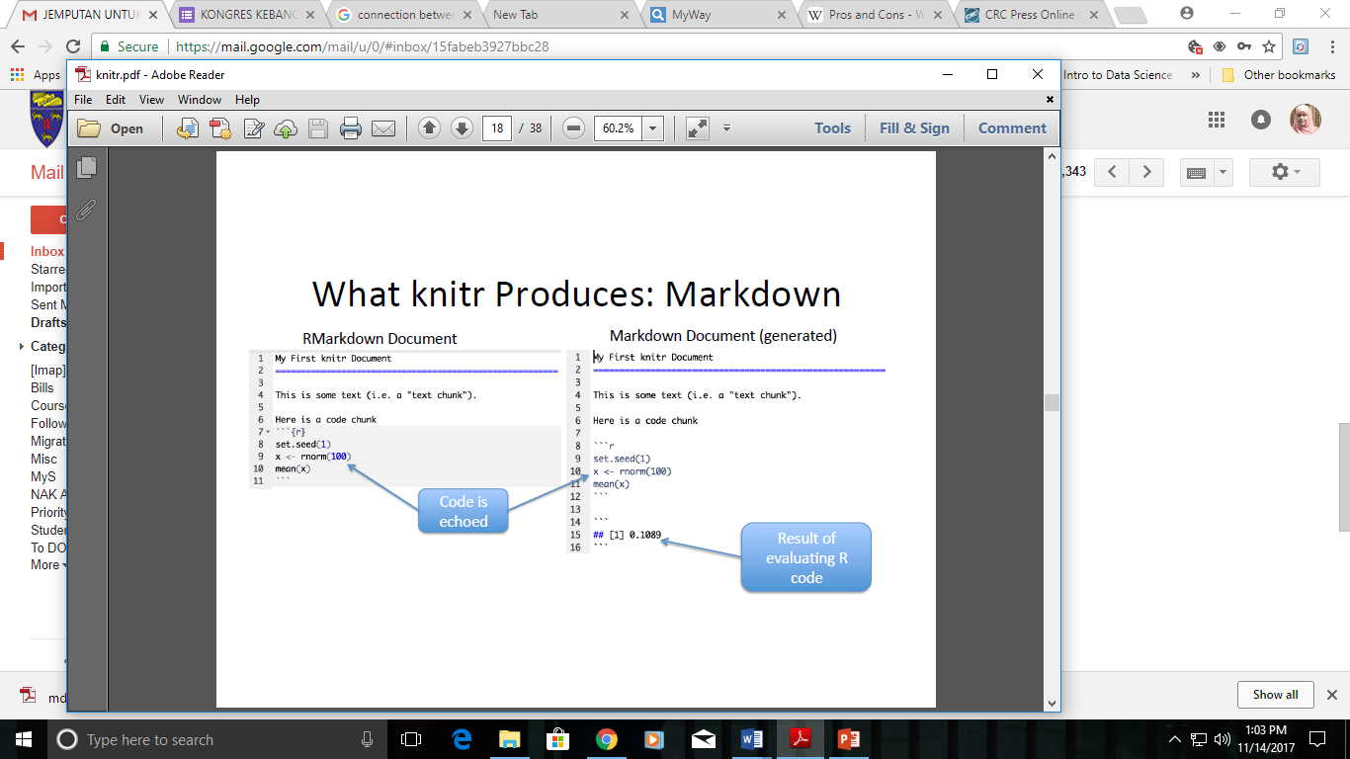
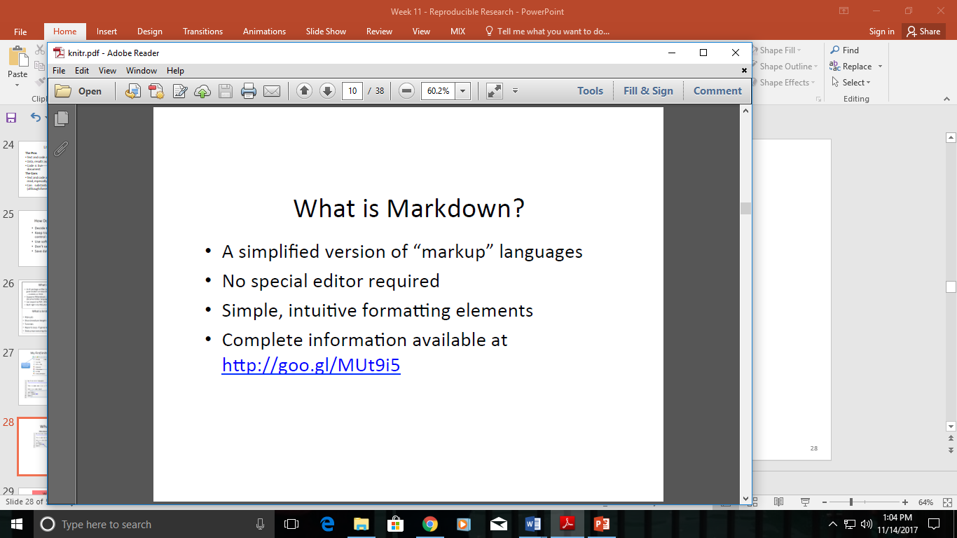

Slide 34
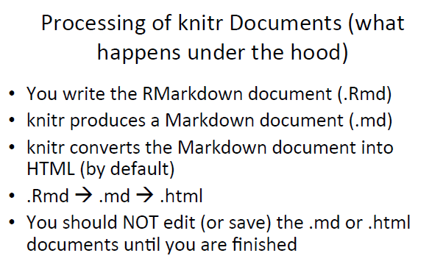

Slide 35
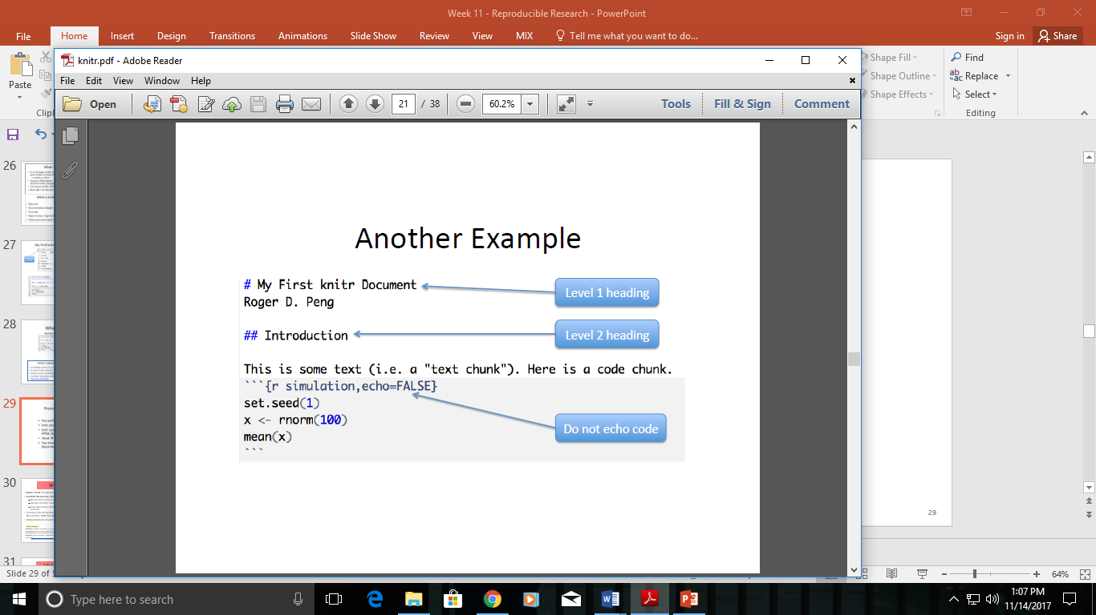
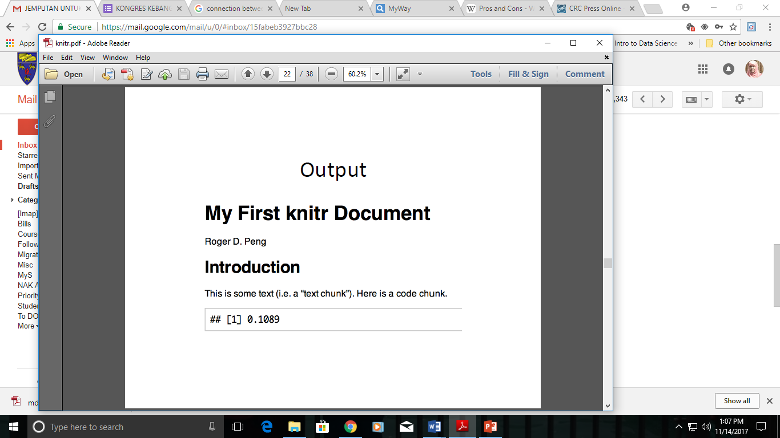

Slide 36
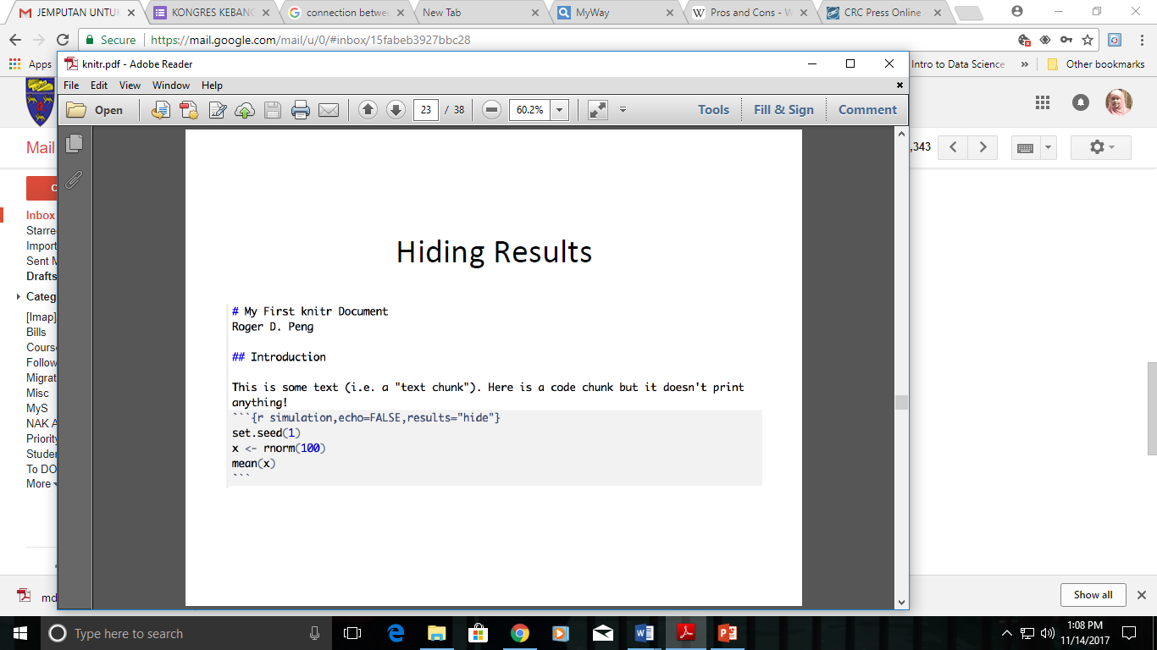
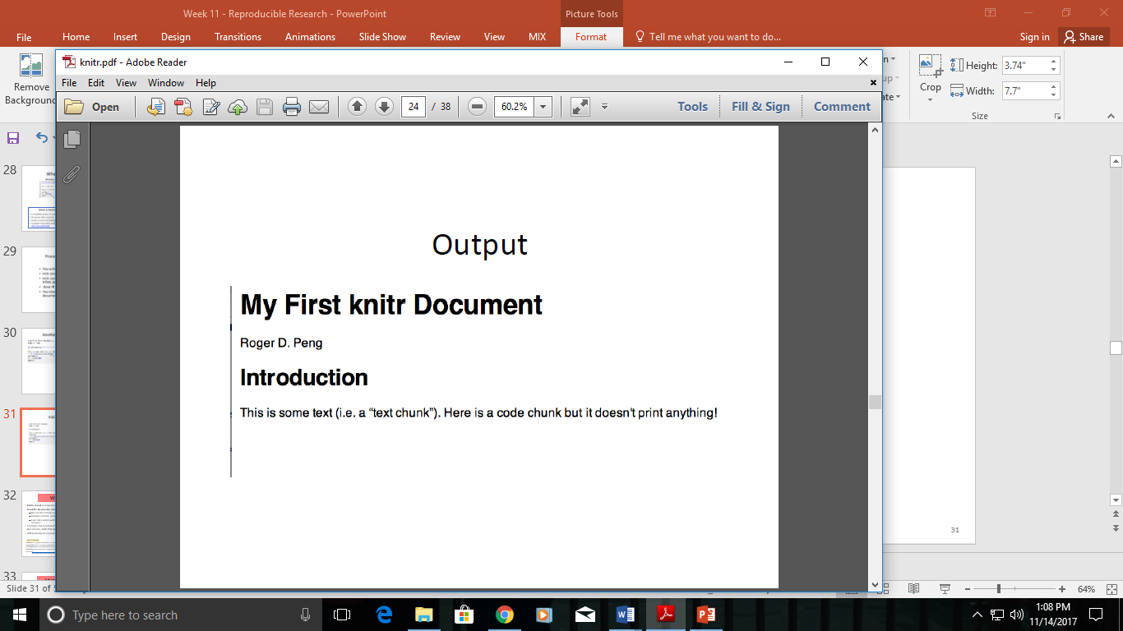

Slide 37
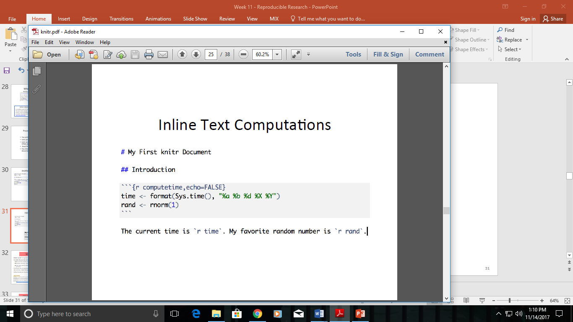
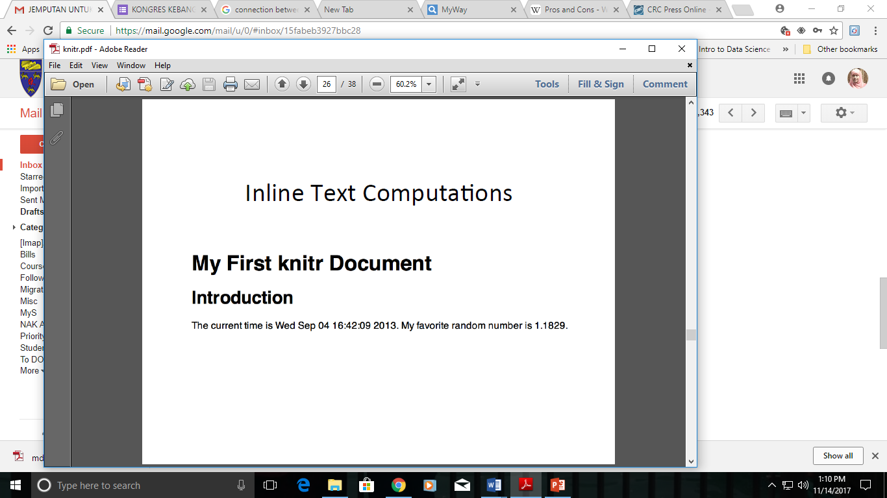

Slide 38




Slide 39



Slide 40


Slide 41



Slide 42

Why do Reproducible Research?
Public Good: transparency.
Good for Researcher (Us): convenience.
We are the future user of our data.
Version control – revert to older versions.
Save time when writing our methods sections.
Starting to be recommended (Journal of Biostatistics, FAIR Principles).
Will probably be required soon.
FAIR Principles
http://figshare.com/blog/2015_The_year_of_open_data_mandates/143
Findable: UIs, good metadata, in a searchable index
Accessible: Quick access to metadata (and hopefully data)
Interoperable: Use established terminologies where available
Reusable: good metadata, usage license, provenance, meets established community standards
http://www.nature.com/articles/sdata201618

Slide 43

Advantages of Reproducible Research
Published findings can be verified.
Alternative analyses conducted.
Challenge uninformed criticisms.
Make it easier to discover false results and avoid retractions.
Expedite exchange of ideas among investigators.
Increase collaboration capabilities (obvious): science is all "about collaboration“
Information will be more visible and directly usable:
Researchers will advance technology more easily.
Practitioners will develop new products faster.
RR can reduce the quantity of "noise" (very important in the era of information curation).

Slide 44


Challenges to Reproducible Research
Concern
“If I give away my data, others will publish results and scoop me!”
“I own my data and ideas, other people don’t necessarily have any rights to them!”
So, why should I just give away my intellectual property?
Is There Such Thing as “Intellectual Property”?
If I copy your book, you still have your book.
If I use your idea, you still have your idea.
If I copy your data, you still have your data.
If I use your statistical model, you still have your statistical model.
If I implement your algorithm, you still have your algorithm.
etc.
Source: Roger D. Peng Slides - Make the World a Better Place through Reproducible Research.

Slide 45

Source: Stodden (IASSIST 2010) sampled American academics registered at the Machine Learning conference NIPS (134 responses from 593 requests (23%). Red = communitarian norms, Blue = private incentives

Slide 46


Slide 47
How to Implement Reproducible Research?
Significant infrastructure for conducting and distributing reproducible research:
Tools for researchers, developers
Software tools
Repositories for datasets
Servers,
Websites
Rights framework for datasets
Protocols, and
Standards for exchanging data, methods,
Other necessary information.

Slide 48
Reproducible Research 101
Begin with the final product in mind
Use literate programming (self-documenting code)
Keep history of changes via code versioning and sharing
Get basic statistics right
Set stringent cutoffs, correct p-values for multiple testing
Be critical, consider batch effects, visualize, do sanity checks, use random controls, cross-validation
Follow reporting guidelines.

Slide 49
Tools to Aid in Reproducible Research
(1) Literate programming, authoring, and publishing tools.
Enable users to write and publish documents that integrate the text and figures seen in reports with code and data used to generate both text and graphical results.
Tools that enable literate programming include both
programming language-specific tools such as WEB, Sweave, and knitR
programming-language independent tools such as Dexy, Lepton, and noweb.
Other authoring environments include SHARE, Doxygen, Sphinx, CWEB, and the Collage Authoring Environment.

Slide 50




Slide 51
Tools to Aid in Reproducible Research
(2) Tools that define and execute structured computation and track provenance
Provenance refers to the tracking of chronology and origin of research objects, such as data, source code, figures, and results.
Tools that record provenance of computations include VisTrails, Kepler, Taverna, Sumatra, Pegasus, Galaxy, Workflow4ever, and Madagascar.

Slide 52




Tools to Aid in Reproducible Research
(3) Integrated tools for version control and collaboration
Tools that track and manage work as it evolves facilitate reproducibility among a group of collaborators.
With the advent of version control systems (e.g., Git, Mercurial, SVN, CVS), it has become easier to track the investigation of new ideas, and collaborative version control sites like Github, Google Code, BitBucket, and Sourceforge enable such ideas to be more easily shared.

Slide 53
Tools to Aid in Reproducible Research
(4) Tools that express computations as notebooks
These tools represent sequences of commands and calculations as an interactive worksheet with pretty printing and integrated displays, decoupling content (the data, calculations) from representation (PDF, HTML, shell console), so that the same research content can be presented in multiple ways.
Examples include both closed-source tools such as MATLAB (through the publish and app features), Maple, and Mathematica, as well as open-source tools such as IPython, Sage, RStudio (with knitr), and TeXmacs.

Slide 54
Tools to Aid in Reproducible Research
(5) Tools that capture and preserve a software environment
New tools make it possible to exactly capture the computational environment and pass it on to someone who wishes to reproduce a computation.
VirtualBox, VMWare, or Vagrant can be used to construct a virtual machine image containing the environment.
Application virtualization tools, such as CDE (Code, Data, and Environment), attach themselves to the computational process in order to find and capture software dependencies.
Computational environments can also be constructed and made available in the cloud, using Amazon EC2, Wakari, RunMyCode.org and other tools.

Slide 55
Reproducibility Skills
version control and use of online repositories,
modern programming practice including unit testing and regression testing,
maintaining “notebooks” or “research compendia”,
recording the provenance of final results relative to code and/or data,
numerical / floating point reproducibility and nondeterminism,
reproducibility on parallel systems,
dealing with large datasets,
dealing with complicated software stacks and use of virtual machines,
documentation and literate programming,
IP and licensing issues, proper citation and attribution.
Learn more
Reference: https://icerm.brown.edu/tw12-5-rcem/icerm_report.pdf

Slide 56
Copyright and Licensing
For reproducibility of scientific findings an attribution-only license is recommended, such as the Apache, MIT, or Modified BSD license.
Copyright does not adhere to raw facts, and so the raw numbers in a dataset do not fall under copyright.
But datasets can have copyright barriers to reuse if they contain “original selection and arrangement” of the data, and for this reason dedication to the public domain is suggested using the Creative Commons CC0 license.
In addition, dataset authors can provide a citation suggestion for others who use the dataset.
These steps will permit shared code and data to be copied, run on other systems, modified, and results replicated, and help encourage a system of citation for both code and data.
What is a Dataset?
Represents already published findings and ideas.
Contains potential findings and ideas yet to be discovered and exploited.
Datasets do not fit well into the framework of copyrights and patents.

Slide 57
Rights for Data
Full access: the data can be used for any purpose.
Attribution: the data can be use for any purpose with a specific citation.
Share-alike: the data can be used for any purpose but any “improvements” must be made available under the same license.
Reproduction-only: the data can only be used for reproducing published results and commenting via a letter to the editor.

Slide 58
A Hierarchy of Reproducibility
Good: Use code. Minimize pointing and clicking (RStudio). Mention availability of code.
Better: Use version control. Help yourself keep track of changes, fix bugs and improve project management (RStudio & Git & GitHub or BitBucket).
Best: Use embedded narrative and code to explicitly link code, text and data, save yourself time, save reviewers time, improve your code. (RStudio & Git & GitHub or BitBucket & Rmarkdown & knitR & data repository).

Slide 59

Refer to: http://reproducibleresearch.net/how-to-make-a-paper-reproducible/

Slide 60

Models for Reproducibility

Slide 61

Models for Reproducibility

Slide 62


Slide 63
What Problem Does Reproducibility Solve?
What we get:
Transparency
Data Availability
Software / Methods Availability
Improved Transfer of Knowledge
What we do not get:
Validity / Correctness of the analysis
An analysis can be reproducible and still be wrong.
We want to know “can we trust this analysis?”
Does requiring reproducibility deter bad analysis?

Slide 64




References
Site about reproducible research
http://reproducibleresearch.net/
http://reproducibleresearch.net/links/
https://www.plos.org/publications
https://osf.io/

Slide 65

Conclusion
Reproducible research
A way to improve our daily work, with immediate benefits.
An opportunity to think about our practices.
A research field of its own.
Many solutions and tools are now ready for use.
It is important to promote a culture change that will integrate computational reproducibility into the research process.
Reproducible will be the default in future.
https://rpubs.com/Salimah/143370

Slide 66
Acknowledgement
Roger Peng
Mikhail Dozmorov
Victoria Stodden
https://www2.stat.duke.edu/courses/Fall15/sta112.01/post/app_ex/app_Twitter_election_results.html

Slide 67


